Slide 1
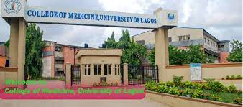

BASIC HISTOLOGY
OSIAGWU DANIEL
MLS 334
(3 UNIT)

Slide 2
BASIC TISSUES OF THE HUMAN BODY
Epithelial tissues
Connective tissue
Muscular tissue
Nervous tissue
Note: Histology: Study of tissues
Tissues: Group of cells with similar functions and morphology.

Slide 3
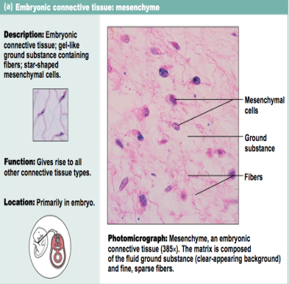
GERM LAYERS
A germ layer is a primary layer of cells that forms during embryonic development
They interact with each other as the embryo develops and contribute to the formation of all tissues and organs

Slide 4
The 3 germ layers
Ectoderm
Mesoderm
Endoderm
Almost all animal form two or three germ layers
ECTODERM LAYER :- Epidermis of skin
Epithelium of conea
Nervouse system
MESODERM LAYER :-
Male and female reproductive tract
Lining epithelium of kidneys
Respiratory tract.
ENDODERM LAYER :-
Lining the GIT

Slide 5
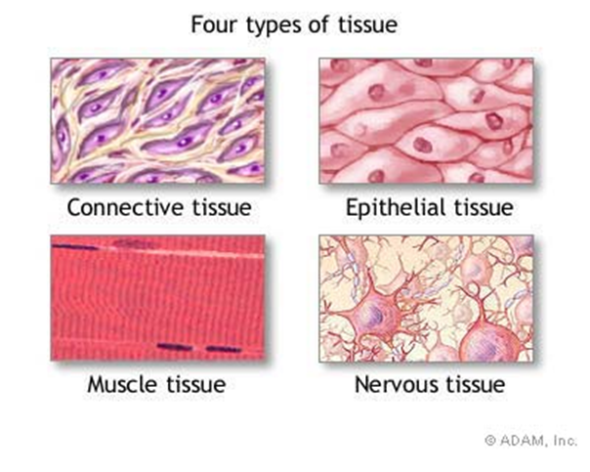
Histology of the tissues

Slide 6
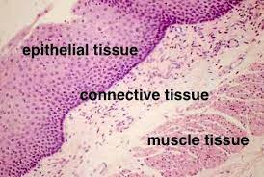

Slide 7
SIMILARITIES B/W TISSUE TYPES:
1. All contain cells
2. Similar functions
TERMINOLOGY
Terms referring to the layers
One layer = Simple
More than one layer = Stratified
False layered
(appears to be multiple layer, but only one)
= Pseudostratified
Have cilia = Ciliated
Terms referring to the cell shapes
Flat = Squamous
Cube = Cuboidal
Rectangular (column) = Columnar
Ability to change shape = Transitional

Slide 8
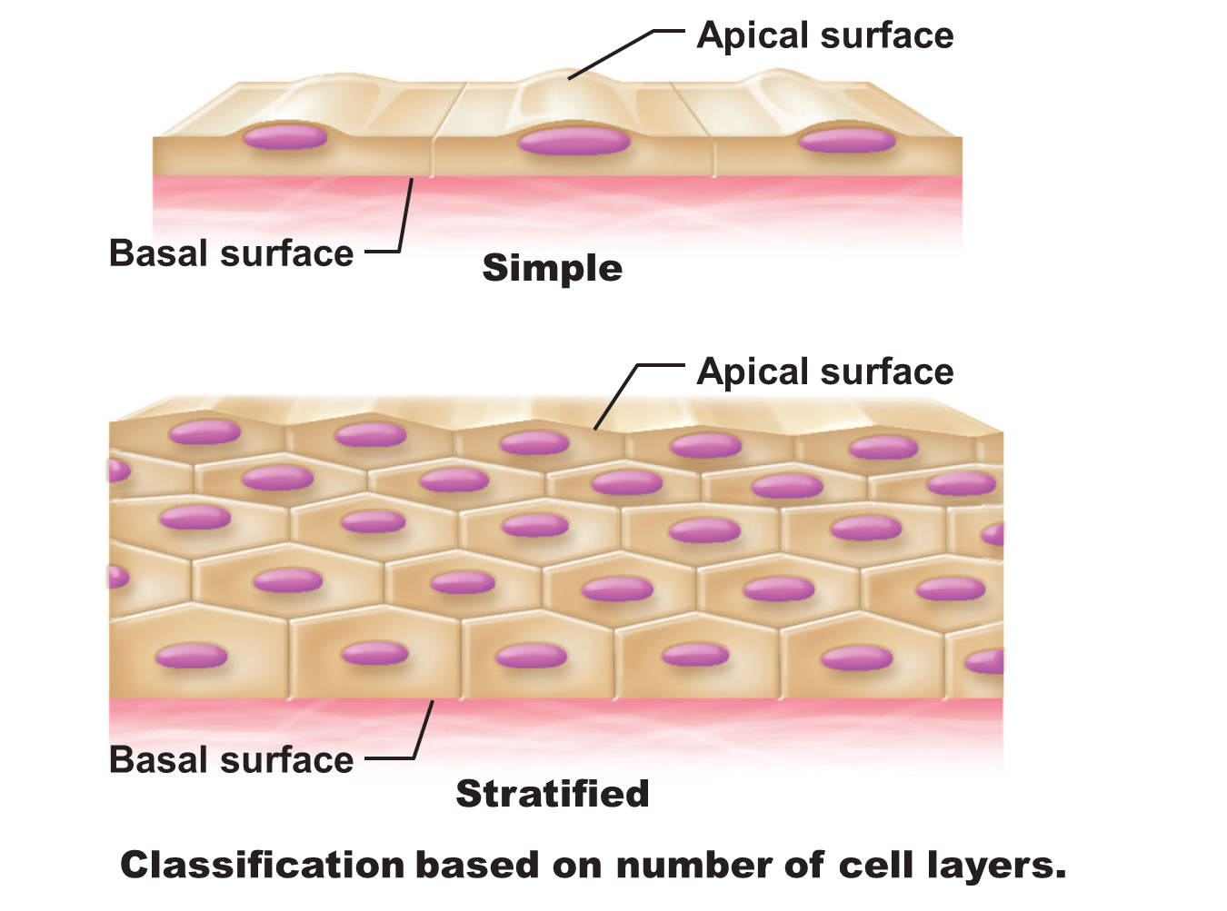
Classification based on number of cell layers.

Slide 9
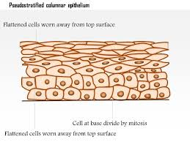
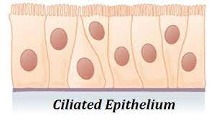
Classification based on number of cell layers.
Pseudostratified
Ciliated

Slide 10
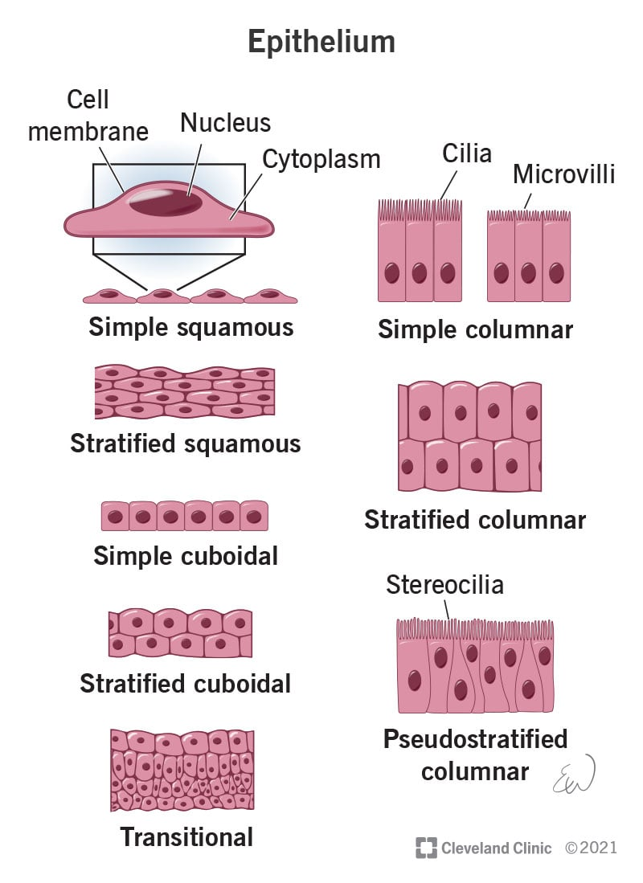

Slide 11
EPITHELIAL TISSUE
Epithelium is one of the four basic tissues which form the organs
Act as boundaries for
Segregation
Sensation
Protection
Transport
Secretion
Epithelia are classified first by thickness:
Simple:
one cell layer thick, or one cell separates the free (luminal, apical) surface from the underlying basement membrane.
Stratified:
many layers of cells which grow from the basal lamina upward and eventually shed into the lumen or free surface.

Slide 12
CHARACTERISTICS OF EPITHELIAL TISSUE
Formed by epithelial cells
Cells are packed or closed together
Cells are extremely cohesive
Requires relatively strong force to seperate them
Provided with a basement membrane/basal laminar on their basal surface.
Avascular tissues (lack blood vessels)
Supported by connective tissues (attached to a basement membrane)
Derived from 3 germ layers in the embryo

Slide 13
FUNCTIONS OF EPITHELIAL TISSUES
Protection : covering and lining the surface of the body e.g Epidermis
Secretion : Glands
Sensory receptor: Neuroepithelium
Filtration : lining epithelium of the kidneys
Lubrication : glands secreting mucous e.g Brunner’s gland, goblet cell, oesophageal glands
Excretion : lining epithelium of tubules of kidney
Absorption : lining epithelium of the intestine

Slide 14
CLASSIFICATION OF EPITHELIAL TISSUE
COVERING/SURFACE EPITHELIUM
GLANDULAR EPITHELIUM
COVERING /SURFACE EPITHELIUM
Membranous layers that covers the external body surface or lines the cavities of the body
Subtypes
According to the number of cell layers
According to the shape of the cells
According to the number of cell layers
SIMPLE
Lined by single layer of cells
They are well adapted for exchange and filtration function

Slide 15
Stratified
Pseudostratified –
False layered (appears to be multiple layer, but only one)
Ciliated - Have cilia
Simple cuboidal – Single layer of cuboidal cells e.g.
Covering of Ovary
Tubules of kidney
Thyroid follicles
Pigment epithelium of the retina
Simple columnar - Single layer of columnar cells e.g.
Intestines
Gall bladder
Uterus and oviducts

Slide 16
CLASSIFICATION OF EPITHELIAL TISSUE cont.
Stratified – lined by several layers of columnar cells
Well adapted for protection purpose
According to the shape of the cells
Simple squamous – single layer of flat cells. E.g.
Mesothelium of blood cavities
Endothelium of blood vessels
Parietal layer of Bowmans capsule
Thin loop of Henle in kidney

Slide 17
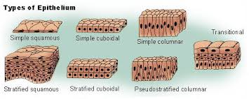
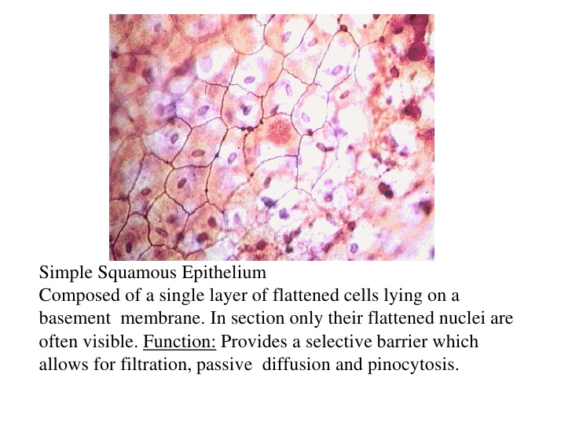
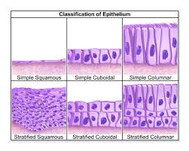

Slide 18
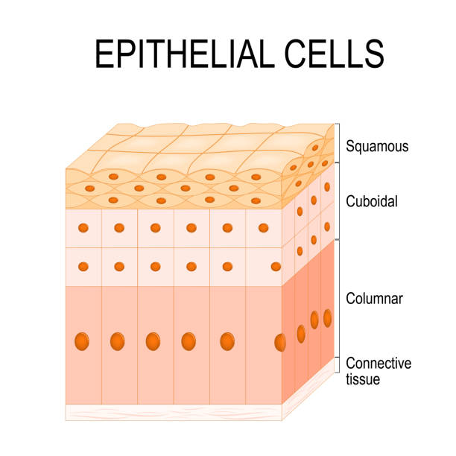

Slide 19
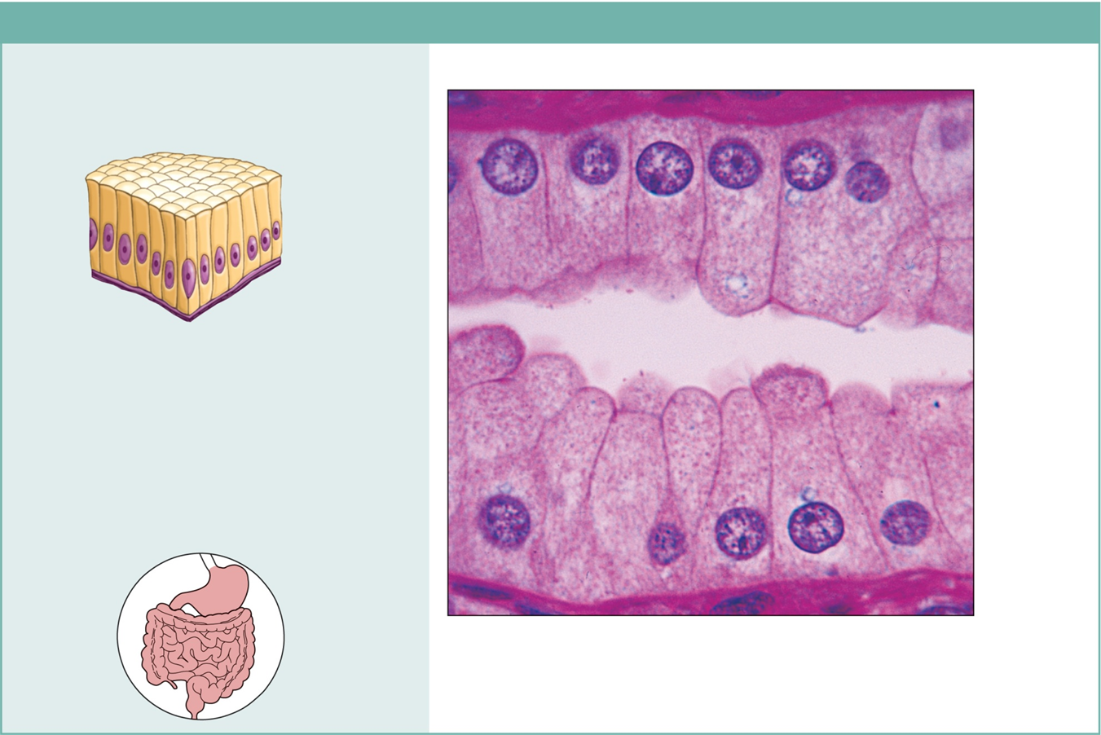
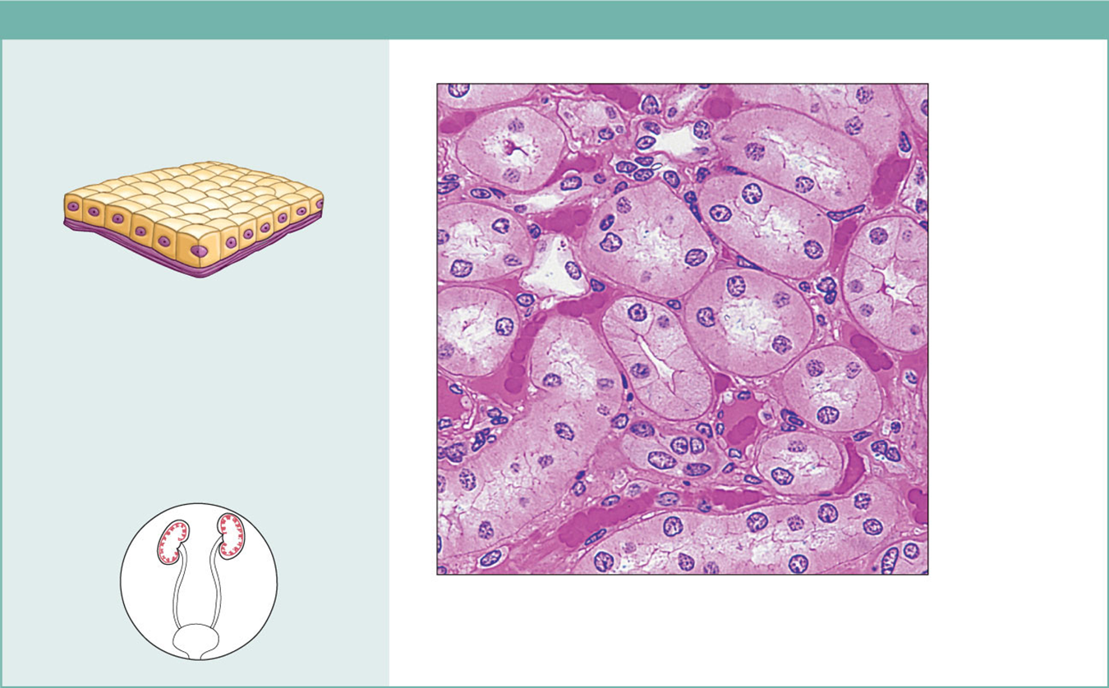
Simple cuboidal and columnar epith.
Photomic: Simple cuboidal
epithelium in kidney tubules (430x).
Photomic: Simple columnar epithelium of the stomach mucosa (860X).

Slide 20
Classification of epithelial tissues cont.
According shape of cell cont.
Stratified squamous epithelium
1. Stratified squamous keratinized /cornified e.g.
Epidermis of skin
2. Stratified squamous non-keratized /non-cornified e.g.
Lining epithelium of the mouth
Oesophagus and vagina
Anal canal
Stratified cuboidal e.g.
Ducts of sweat glands
Developing ovarian follicles
Stratified columnar e.g.
Parts of male urethra

Slide 21
Classification of epithelial tissues cont
3. Pseudostratified
Modification of simple epithelium
All cells are in contact with the basal lamina
But not all of them reach the Apical surface
Shape of cells are variable
False stratification e.g. respiratory epithelium – pseudostratified columnar epithelium with Goblet cells
4. Transitional
Modification of stratified epithelium
The number of cell vary with the functional state of the organs
Also called Uroepithelium e.g.
Lining epithelium pf excretory passages of the urinary system

Slide 22
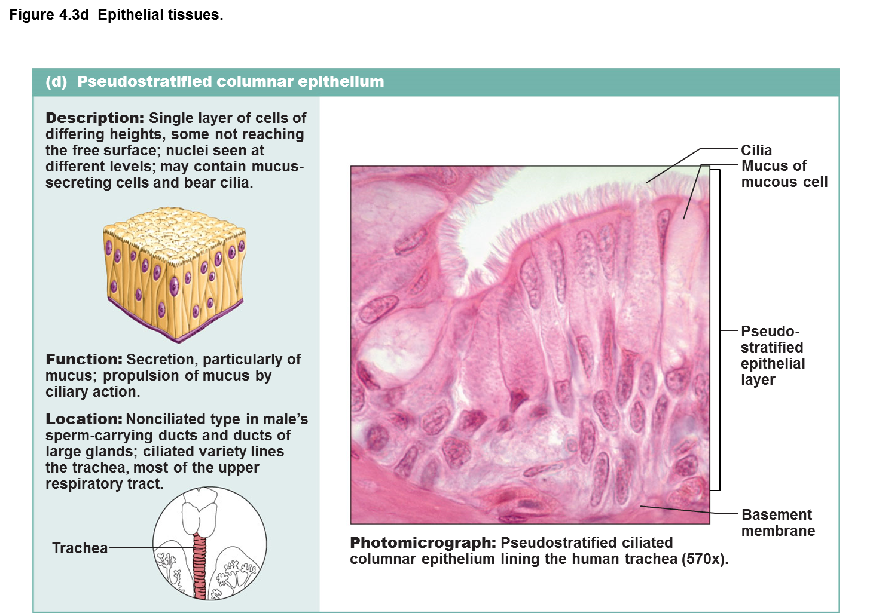
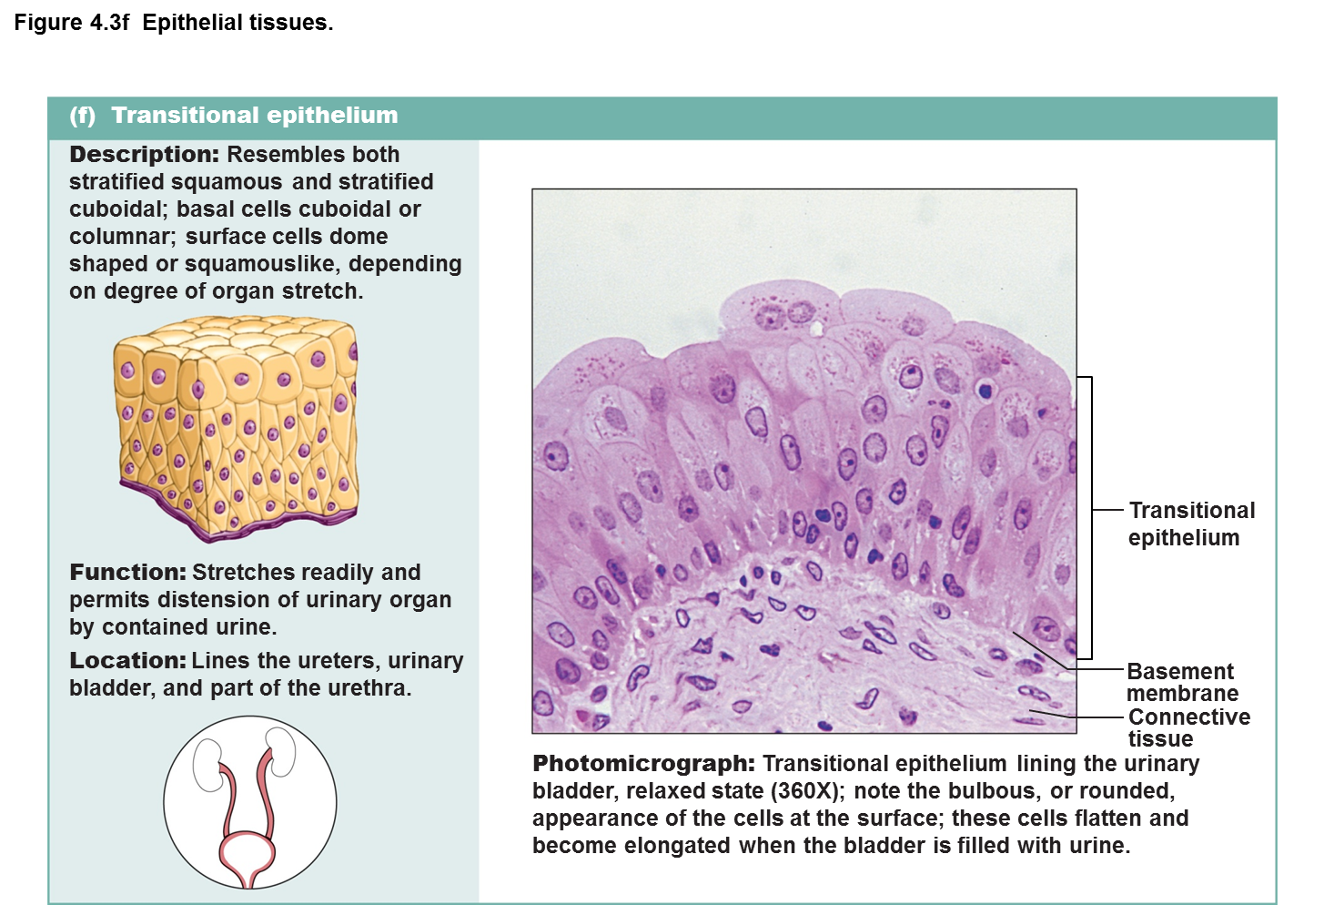
Transitional and pseudostratified epith.

Slide 23
GLANDULAR EPITHELIUM
GLANDULAR EPITHELIUM
A type of cell that makes mucus and is found in tissue that lines the inner part of the cervix.
Abnormal glandular cells may be found in Pap tests and may be a sign of cancer or other serious condition
According to number of cells
According to fate of secretion
According to manner of secretion
According to morphology
According to type of secretion

Slide 24
According to number of cells
unicellular
Multicellular gland
According to number of cells
Unicellular –
Single secreting cells : Goblet cell of the lining of
Respiratory tract
Intestinal tracts
Multicellular gland - Salivary glands
According to fate of secretion
Apocrine
Holocrine
Merocrine
Apocrine gland – partial destruction of secretory cells e.g. mammary gland

Slide 25
Holocrine gland – total destruction of secretoy cells e.g sebaceous gland
Merocrine gland – No destruction e.g. sweat gland
According to manner of secretion
Exocrine
Endocrine
Exocrine gland – Provided with duct
e.g.
Salivery glands
Gastric glands
Endocrine gland – Ductless gland
e.g. Pituitary gland
Thyroid gland

Slide 26
Classification of glandular epithelium
According to morphology
Simple
Compound
Simple :
Simple tubular - simple epithelium lined tubules, in a straight course which opens to the surface e.g intestinal glands.
Simple coiled tubule –
deeper portion of the tubule is convoluted or coiled e.g. sweat glands.
Simple branched tubule – deeper portion of the tubule divided into tube- like structure e.g uterine glands
Simple branched alveolar/acinar – made up of numerous sac-like structures e.g. sebaseous glands
Compound :
Compound tubular – Cardiac gland of stomach
Brunners gland

Slide 27
Classification of glandular epithelium cont.
Compound alveolar – Mammary glands
Compound tubulo-alveolar - Salvary glands
Oesophageal glands
According to type of secretion
Serous gland – thin and watery secretion e,g sweat gland
Mucous gland – thick and viscous e.g. sebaceous gland
Mixed gland – maco-serous secretion e.g. sublingual and
submaxillary glands
Cytogenic gland – secretion produces cells e.g. testis and ovary

Slide 28
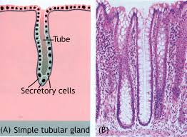
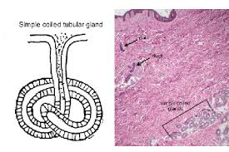
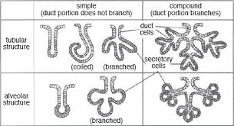
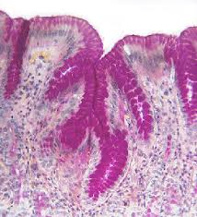
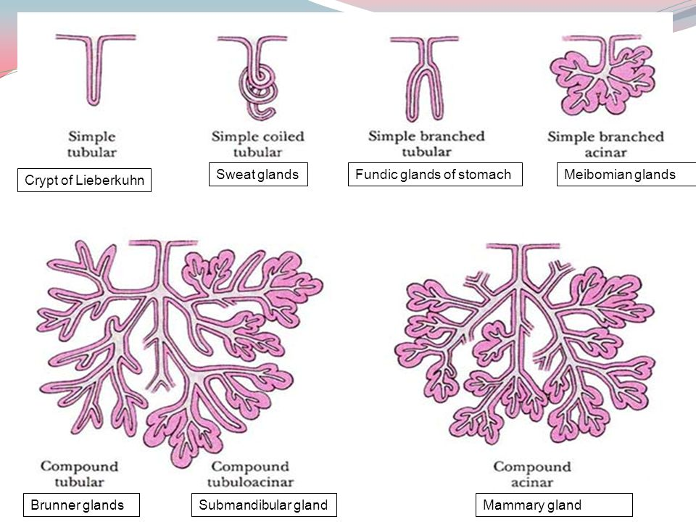

Slide 29
CONNECTIVE TISSUES
Charateristics
Cells are relatively few and far apart
Contains abundant intracellular substances
Containing tissue fluid
Ground substances (extracellular matrix} and
Intracellular fibers.
Very vascular
Derived from mesoderm

Slide 30
FUNCTIONS OF CONNECTIVE TISSUES
Protection
Connect
Bind and support organs and tissues of the body
Fat storage and insulator
Immunity
Repair
Hematopoetic functions

Slide 31
Classification of connective tissues
Fibrous:
Collagenous
Elastic
Reticular
Adipose
Mucous
Blood
Lymphatic
Bone/osseous
Cartilage
Myeloid

Slide 32
Categories of connective tissue
They are categorized into two:
Fixed cells
Wandering cells
Fixed cell – parmanent
Fibroblasts – principle cells responsible for the synthesis of
fibers and ground matrix: stellate shaped with multiple
processes
Mesenchymal cells – known as pluripotential cells
Fat / adipose cells – characteristic ‘’’ Signet ring’’ appearance
Reticular cells

Slide 33
Categories of connective tissue cont.
Wandering cells – trancient
Plasma cells – ovoid cells with eccentric nucleus and intensely basophilic, ‘’ cartwheel or spokewheel appearance of nucleus’’
Mast cells – with cytoplasmic granule containing heparin and histamine
White blood cells
Connective tissue fibres
The connective tissue fibres are:
Collagen
Elastic
Recticulin

Slide 34
Connective tissue fibres cont.
Collagen | Reticulin | Elastic
Colourless to white | Argyrophilic reacts with silver stains | yellowish
Elastic and have greater strenght | Very slender, forming delicate net-like pattern | Slender refractile fibers
Most abundant and widely distributed | Hematopoetic and lymphoid organs | Walls of blood vessels and organs capable of distention

Slide 35
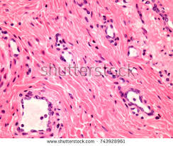
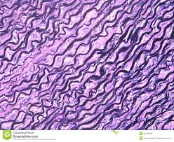
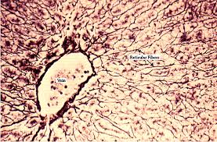
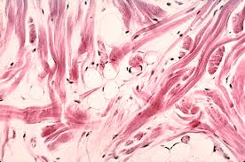
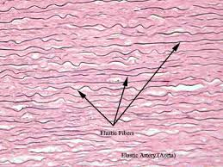
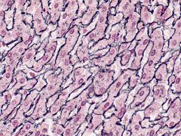

Slide 36
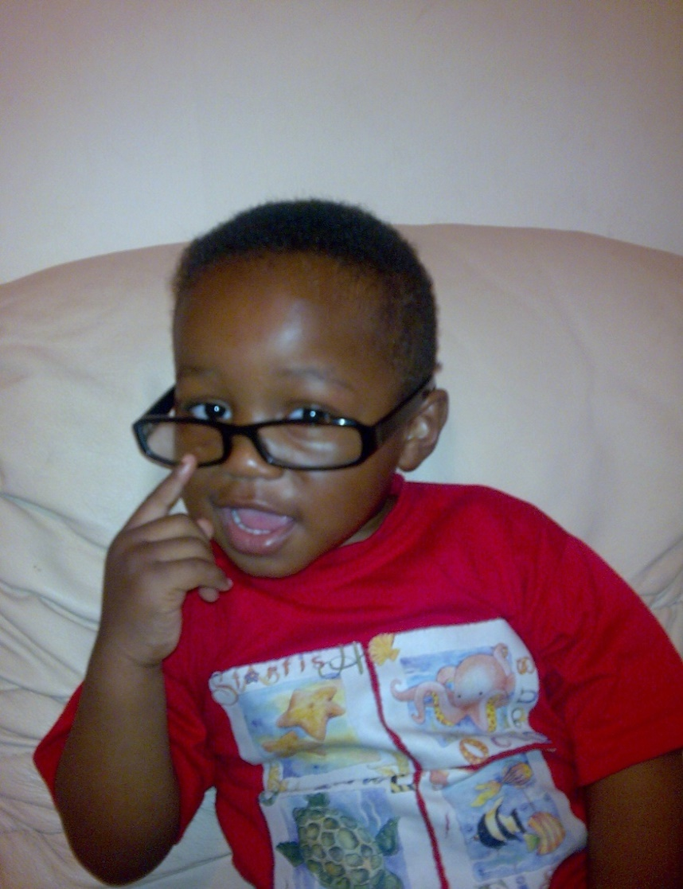
Learn to love unconditionally. Quit being judgemental of people.
Don’t short some out.
If you have been were they have been, fought the battles they have fought. Then you will appreciate them better and know that they are on a journey.

